Slide 1

Regional Criteria and Standards for N and P Loads in Domestic and Industrial Wastewater Discharges
Seventh Meeting of the Scientific and Technical Advisory Committee of the Protocol Concerning Pollution from Land-Based Sources and Activities (7th LBS STAC)
Maurice Narcis, PhD
Institute of Marine Affairs
24th July, 2025

Slide 2
Summary
Background
Methodology
N and P
Existing Effluent Limits
Proposed Guidelines
Recommendations

Slide 3
Background
SSFA Project Activity - Establish regional criteria and standards for N and P loads in domestic and industrial wastewater discharges with support by RAC CIMAB
  Summary of the criteria and national standards of the English-speaking countries of the Wider Caribbean Sea for N and P for discharges or discharges of industrial and domestic wastewater.
  Summary of criteria and standards for N and P in other regions or countries for discharges or discharges of industrial and domestic wastewater.
  Surveys to national or regional experts from English-speaking countries on limits, criteria or standards for N and P, including which compounds they propose and the limits.
  Sub-regional report with the proposed criteria or standards for N and P that will include types of compounds and limits in the form of concentration or in the form of pollutant load.
  Survey on designation of sensitive sites in countries or classification system.
  The following will be used as elements to consider in the establishment of the criteria and standards: Regulatory framework in country for pollution control and Key Economic and Water related statistics.
  Integration of the results of both reports (sub-regional studies) and preparation of the final report in both languages.

Slide 4
Background
Twenty (20) countries assessed – 10 English Speaking and 10 Spanish Speaking countries
Questionnaire designed by both RACs was circulated to respective LBS focal points
Literature review was conducted on global examples from Europe, Australia etc.

Slide 5
Countries Assessed for Existing N and P Limits
Antigua and Barbuda
The Bahamas
Barbados
Belize
Grenada
Guyana
Jamaica
Saint Lucia
Trinidad and Tobago
United States of America
Colombia
Costa Rica
Cuba
Guatemala
Honduras
Mexico
Nicaragua
Dominican Republic
Panama
Venezuela

Slide 6
Methodology
Questionnaire was circulated to respective LBS focal points of each country
The aim was to collect information on the existing regional N and P criteria/limits/standards and respective compounds proposed by each country.
7 countries (Barbados, Belize, Guyana, Honduras, Jamaica, Trinidad and Tobago and the United States of America) responded to the questionnaire

Slide 7
Methodology
Due to limited feedback, a desktop study was completed to gather any existing information on N and P limits
Main data sources were legal instruments from each country related to the subject (wastewater regulations, standards, water quality criteria, resolutions, laws, decrees)
The results obtained in each sub-regional study were collated, organized and then integrated for presentation under a single regional report.

Slide 8
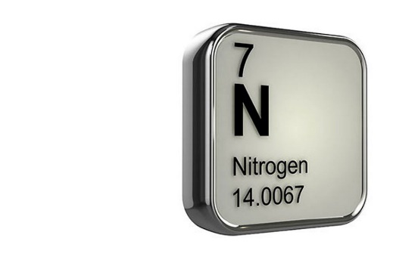
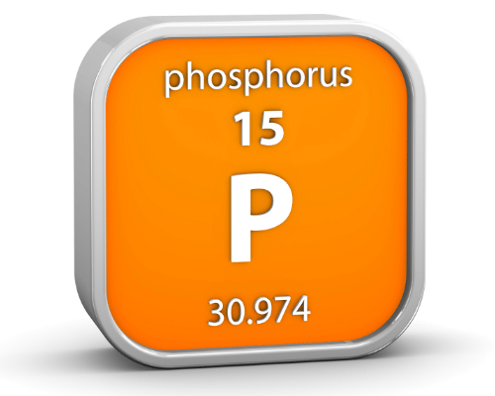
N and P
Nitrogen (N) and Phosphorous (P)
Can be present in various forms in water, wastewater (domestic and industrial effluent)
Commonly referred to as Nutrients
Nitrogen
nitrate (NO₃), nitrite (NO₂), ammonia (NH₃) with corresponding forms (N–NO₃, N–NO₂, N-NH₃), ammonium (NH₄⁺), Total Nitrogen (TN)
Phosphorous
phosphates (PO₃⁻⁴), orthophosphates (P-PO₃⁻⁴), Total phosphates (TP)

Slide 9
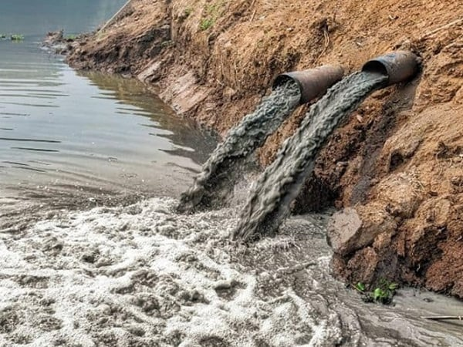
The Nutrient Problem
Land based activities are mostly responsible for pollution of the marine environment that adversely impacts our marine ecosystems and their ecosystem services.
Agricultural runoff, domestic wastewater, untreated sewage, industrial effluent, and atmospheric releases from fossil fuel combustion are the main anthropogenic sources of nutrients to the marine environment
The increase in nutrients to freshwater or marine systems, which leads to Eutrophication - increased plant growth and often to undesirable changes in ecosystem structure and function.
Toxic algal blooms often called “red tides”
Hypoxic zones due to oxygen depletion by increased phytoplankton
Degradation of marine habitats, including coral reefs and sea-grass beds
Death of fish, shellfish & contaminated seafood resulting in poisoning

Slide 10
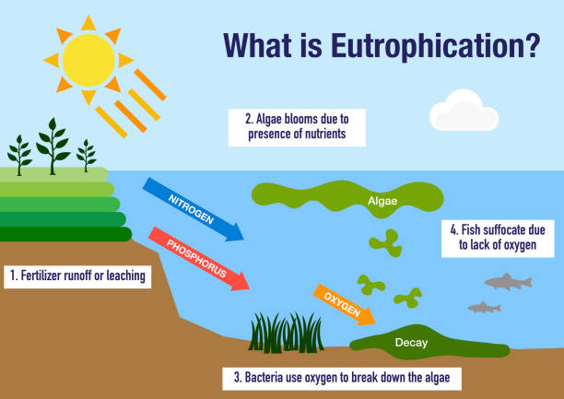
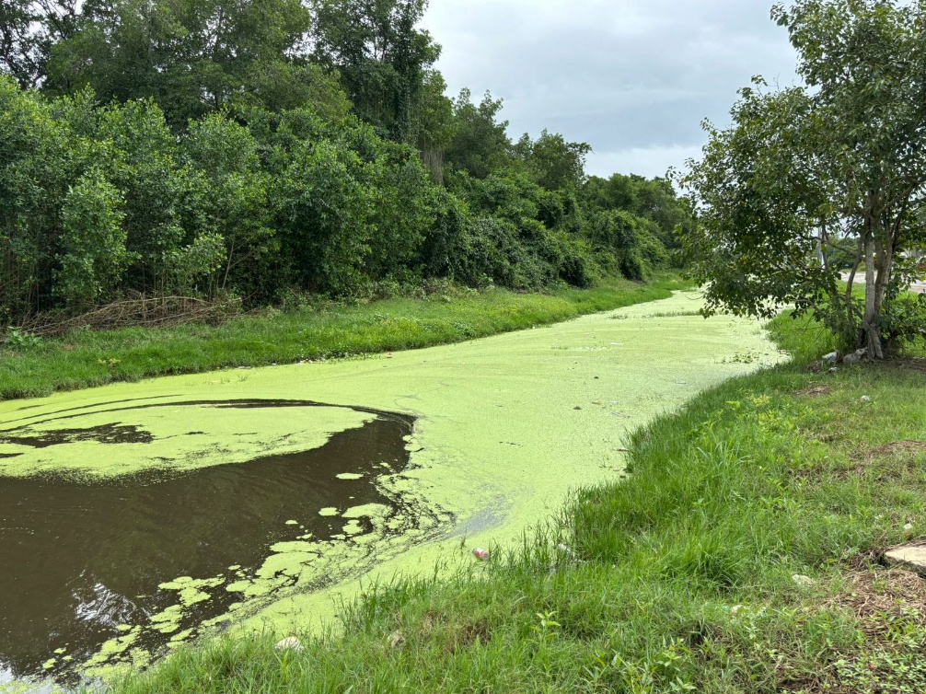
The Nutrient Problem

Slide 11
LBS Discharge Limits
Class I
Class II
Parameter | Effluent Limits
Total Suspended Solids | 30 mg/l*
Biochemical Oxygen Demand (BOD₅) | 30 mg/l
pH | 5-10 pH units
Fats, Oil and Grease | 15 mg/l
Faecal Coliform (Parties may meet effluent limitations either for faecal coliform or for E. coli (freshwater) and enterococci (saline water).) | Faecal Coliform: 200 mpn/100 ml; or a. E. coli: 126 organisms/100ml; b. enterococci: 35 organisms/100 ml
Floatables | not visible
* Does not include algae from treatment ponds
Parameter | Effluent Limits
Total Suspended Solids | 150 mg/l*
Biochemical Oxygen Demand (BOD₅) | 150 mg/l
pH | 5-10 pH units
Fats, Oil and Grease | 50 mg/l
Floatables | not visible
* Does not include algae from treatment ponds

Slide 12
Standards, Criteria and Environmental Quality
Water Quality Regulations
  Discharges are generally arranged into Effluent Limitations
  Directly limit the wastewater discharge to receiving water bodies
  Determining maximum permissible limits (MPL) for certain pollutants in the form of concentration or load
Environmental Quality Standards (EQS)
  Ambient concentrations of parameters existing in the air, water or soil.
  Sufficiently low so as to not represent a significant risk to human health or the environment.
  These quality standards are not legal requirements, but rather, are used to establish environmental policies.
Maximum Permissible Limits (MPL)
  Measures of the concentration or load of parameters that characterise an effluent or pollutant
Water Quality Criteria
  Application of Standards to a water body with a designated use to maintain/protect ambient water quality

Slide 13
Effluent Limitations for Domestic Wastewater
Country | Wastewater Source | Receiving body | Parameters (mg/L)
 |  |  | P or TP | PO₄³⁻ | P-PO₄³⁻ | N or TN | TKN | NO₃⁻ | N-NO₃⁻ | NO₂⁻ | N-NO₂⁻ | N-NH₃ | N-NH₄⁺ | N-NH₄⁺ + NO₃
Antigua and Barbuda | Sewage | Coastal waters |  |  |  |  |  | 50 |  | 3
Barbados | Domestic Wastewater | Class 1 - Coastal | 1 |  |  | 5
 |  | Class 2 - Marine | 10 |  |  | 45
Jamaica | Sewage effluents from existing treatment plants | Coastal waters |  | 10 |  |  |  |  | 30
 | Sewage effluent from plants other than existing plants |  |  |  | 4 | 10
Saint Lucia | Domestic Wastewater | Coastal and Recreational Waters | 1 |  |  | 5

Slide 14
Effluent Limitations for Domestic Wastewater
Country | Wastewater Source | Receiving body | Parameters (mg/L)
 |  |  | P or TP | P0₄³⁻ | P-P0₄³⁻ | N or TN | TKN | NO₃⁻ | N-NO₃⁻ | NO₂⁻ | N-NO₂⁻ | N-NH₃ | N-NH₄⁺ | N-NH₄⁺ + NO₃
Colombia | Domestic wastewater and industrial, commercial and service activities. | Marine waters | 0.4 |  | 0.3 | 1 |  |  | 0.1 |  | 0.02 | 0.3
Cuba | Sewage water (Does not specify the typology). | Marine areas of ecological conservation zones or protected areas. (Class A). | 5 |  |  |  | 10
 |  | Marine areas where fishing takes place (Class C). | 7 |  |  |  | 20
 |  | Marine areas whose waters are for industrial use (Class D). | 10 |  |  |  | 40
 |  | Marine areas in bays where maritime-port activity takes place (Class E). | 5 |  |  |  | 20
 |  | Marine areas in bays where maritime-port activity takes place (Class F). | 10 |  |  |  | 40
Dominican Republic | Municipal wastewater for populations over 10,000 inhabitants. For minors not determined. | Coastal waters |  |  | 8 |  |  |  |  |  |  |  | 30 | 50

Slide 15
Effluent Limitations for Domestic Wastewater
Country | Wastewater Source | Receiving body | Parameters (mg/L)
 |  |  | P or TP | P0₄³⁻ | P-P0₄³⁻ | N or TN | TKN | NO₃⁻ | N-NO₃⁻ | NO₂⁻ | N-NO₂⁻ | N-NH₃ | N-NH₄⁺ | N-NH₄⁺ + NO₃
Guatemala | Municipal wastewater with complete treatment systems, at least, for the two (2) main discharges that are reported without treatment in the inventory. | Receiving bodies, unspecified. | 40 |  |  | 150
 | Municipal wastewater with treatment systems for 60% of discharge |  | 20 |  |  | 70
 | Municipal wastewater with treatment systems for 40% of discharges |  | 10 |  |  | 20
Honduras | Wastewater (their origin is not specified) | Receiving body | 5 |  |  |  | 30 |  |  |  |  | 20
México | Wastewater (their origin is not specified) | Marine zones | 15 |  |  | 25
Nicaragua | Discharges from sanitary sewer treatment systems | Receiving bodies | 15 |  |  | 45
 | Discharges from domestic wastewater treatment systems |  | 10 |  |  | 30
Panamá | All liquid effluents from domestic, commercial, industrial, and institutional activities. | Continental and marine waters | 10 |  |  | 15 |  | 10 |  |  |  | 3
Venezuela | For all wastewater discharges. (It does not specify its type). | Marine and coastal environment | 10 |  |  | 40

Slide 16
Regulatory Frameworks For Domestic Wastewater Discharge
Each of the countries assessed possesses some form of established legislation that prohibits unregulated wastewater discharge into coastal waters
Six of the 10 Spanish speaking countries assessed (Colombia, Panama, Mexico, Venezuela, Cuba and the Dominican Republic), do the regulations clarify or specify the application of numerical values (maximum concentrations) to limit the discharge of domestic wastewater in coastal marine waters.
Six (Antigua & Barbuda, Belize, Jamaica, Saint Lucia, Trinidad & Tobago and USA) have established further regulations inclusive of maximum permissible (concentration) limits or threshold values for wastewater discharge
Four of these countries (Antigua and Barbuda, Barbados, Jamaica and Saint Lucia) have established limits specifically for domestic wastewater discharges
USA utilises its water quality criteria for water bodies, which is comprised of pollutant loads

Slide 17
Effluent Limitations for Industrial Wastewater
Country | Wastewater Source | Receiving body | Parameters (mg/L)
 |  |  | P or TP | PO₄³⁻ | NO₃⁻ | N-NH₃ | N-NH₄⁺
Belize | Food Processing, Service, Citrus, Garment, Battery Manufacturing, Poultry, Brewery Industry, Sugar Processing | Coastal waters |  | 5 | 10
 | Fish Processing |  |  | 30 | 10
 | Dairy Industry |  |  | 5 | 30
 | Rum Refiney, Shrimp Processing, Soft Drink Bottling |  |  | 1 | 10
 | For Other Industries or Commercial Activities |  |  | 3 | 5 |  | 1
Jamaica | Trade effluents | Coastal waters |  | 5 | 10 |  | 1
Trinidad and Tobago | Industries or Commercial Activities | Coastal Nearshore Marine Offshore | 5 |  |  | 10

Slide 18
Effluent Limitations for Industrial Wastewater
Country | Wastewater Source | Receiving body | Parameters (mg/L)
 |  |  | P or TP | PO₄³⁻ | N or TN | TKN | NO₃⁻ | N-NH₃ | N-NH₄⁺
Colombia | Food Industries | Marine waters | 2 |  | 10
 | Beverage |  | 15 |  | 30
Costa Rica | Livestock, Poultry, Fish farming, Textile and Leather industry | Not specified |  | 25 | 50
Dominican Republic | General Industrial wastewater | Coastal waters | 2 |  |  |  |  |  | 10
Nicaragua | Animal Slaughterhouses, Cattle farming, Coffee processing | Marine waters |  |  | 50
 | Dairy industry |  |  |  | 45
 | Textile Manufacturing |  | 2 |  |  |  |  | 10
 | Thermoelectric Power plants |  | 5
 | Oil refining and petrochemicals |  |  |  |  |  |  | 15
 | Iron and steel industry |  |  |  |  |  |  | 12
 | Pig and goat farms |  |  | 20 |  | 50
 | Soap and detergent industry |  | 15

Slide 19
Regulatory Frameworks For Industrial Wastewater Discharge
Less countries have established limits for industrial wastewater.
Only three (3) English Speaking countries (Belize, Jamaica, Trinidad and Tobago) and 4 Spanish Speaking countries (Colombia, Costa Rica, Dominican Republic, Nicaragua) have such regulations.
Jamaica, Dominican Republic and Nicaragua are the only countries with distinct limits defined for both domestic and industrial discharges.
Each country contains different industrial activity resulting in the variety of existing limits
Fewer forms of nitrogen and phosphorus compounds for industrial discharges.

Slide 20
Challenges
Data illustrates a wide range of values for the maximum permissible discharge limits of N and P compounds.
Large range in the types of compounds for N and P that are regulated across the WCR (over 10 different types)
Instances where discharge standards or regulations mention nitrogen compounds without clearly specifying their chemical names (‘Nitrate’ vs NO₃ vs N-NO₃)

Slide 21
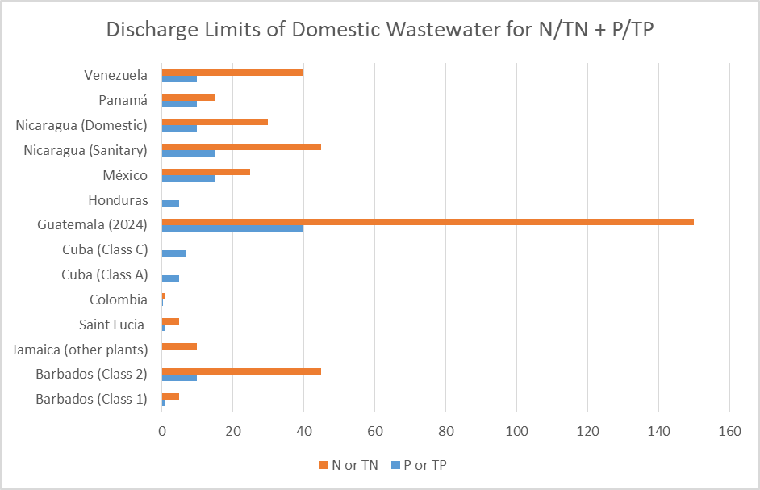
Proposing N and P Discharge Limits for Domestic Wastewater
Country | P or TP (mg/L) | N or TN (mg/L)
Barbados (Class 1) | 1 | 5
Barbados (Class 2) | 10 | 45
Jamaica (other plants) | - | 10
Saint Lucia | 1 | 5
Colombia | 0.4 | 1
Cuba (Class A) | 5 | -
Cuba (Class C) | 7 | -
Guatemala (2024) | 40 | 150
Honduras | 5 | -
México | 15 | 25
Nicaragua (Sanitary) | 15 | 45
Nicaragua (Domestic) | 10 | 30
Panamá | 10 | 15
Venezuela | 10 | 40

Slide 22
Proposed Guidelines for N and P Limits in Domestic Wastewater
Total nitrogen (TN) and total phosphorus (TP) should be included as the nutrient parameters
Due to the importance of determining Total Kjeldahl Nitrogen (TKN) for wastewater treatment systems and recognising the importance of the analytical method for its determination, it is also proposed as an appropriate indicator

Slide 23
Recommendations for Consideration of the Parties
Potential nutrient indicators should initially be considered as a range of values for Class I and Class II waters.
Ranges are intended to be in alignment with each water classification as per the LBS Protocol i.e. stricter limits are proposed for Class I which is in alignment with the protection of sensitive ecosystems and water uses within this classification.
The main objective of this recommendation is for these values to serve as a guideline for contracting parties in the WCR.
With reference to the proposed ranges, contracting parties may choose to adopt limits that are within the range or even have stricter limits.
Maximum Permissible Limits | Parameters (mg/L)
Water Classification | TP | TN | TKN
Class I | 0.1 - 5 | 1 - 10 | 5 - 10
Class II | 5 - 10 | 10 - 50 | 10 - 40

Slide 24
Recommendations for Consideration of the Parties
The differentiation of limitations for domestic wastewater and industrial effluent is required.
Future consideration should be given to introduction of discharge limits in the form of pollutant loads (flow x concentration) which better enables assessment of pollutant effect over time, increased ability to manage pollutant reduction through science-based decision making.

Slide 25
Recommendations to STAC
Contracting Parties endorse the proposal to utilise total nitrogen (TN), total phosphorous (TP) and Total Kjeldahl nitrogen (TKN) as the nutrient parameters for the regional criteria/limits for domestic wastewater discharges in marine and coastal areas.
Contracting Parties that have not yet done so consider differentiating standards for domestic wastewater and industrial effluent to facilitate the management of coastal and marine waters. Further, Contracting Parties are encouraged to consider developing separate standards for industrial effluents.

Slide 26

Thank You

